Slide 1
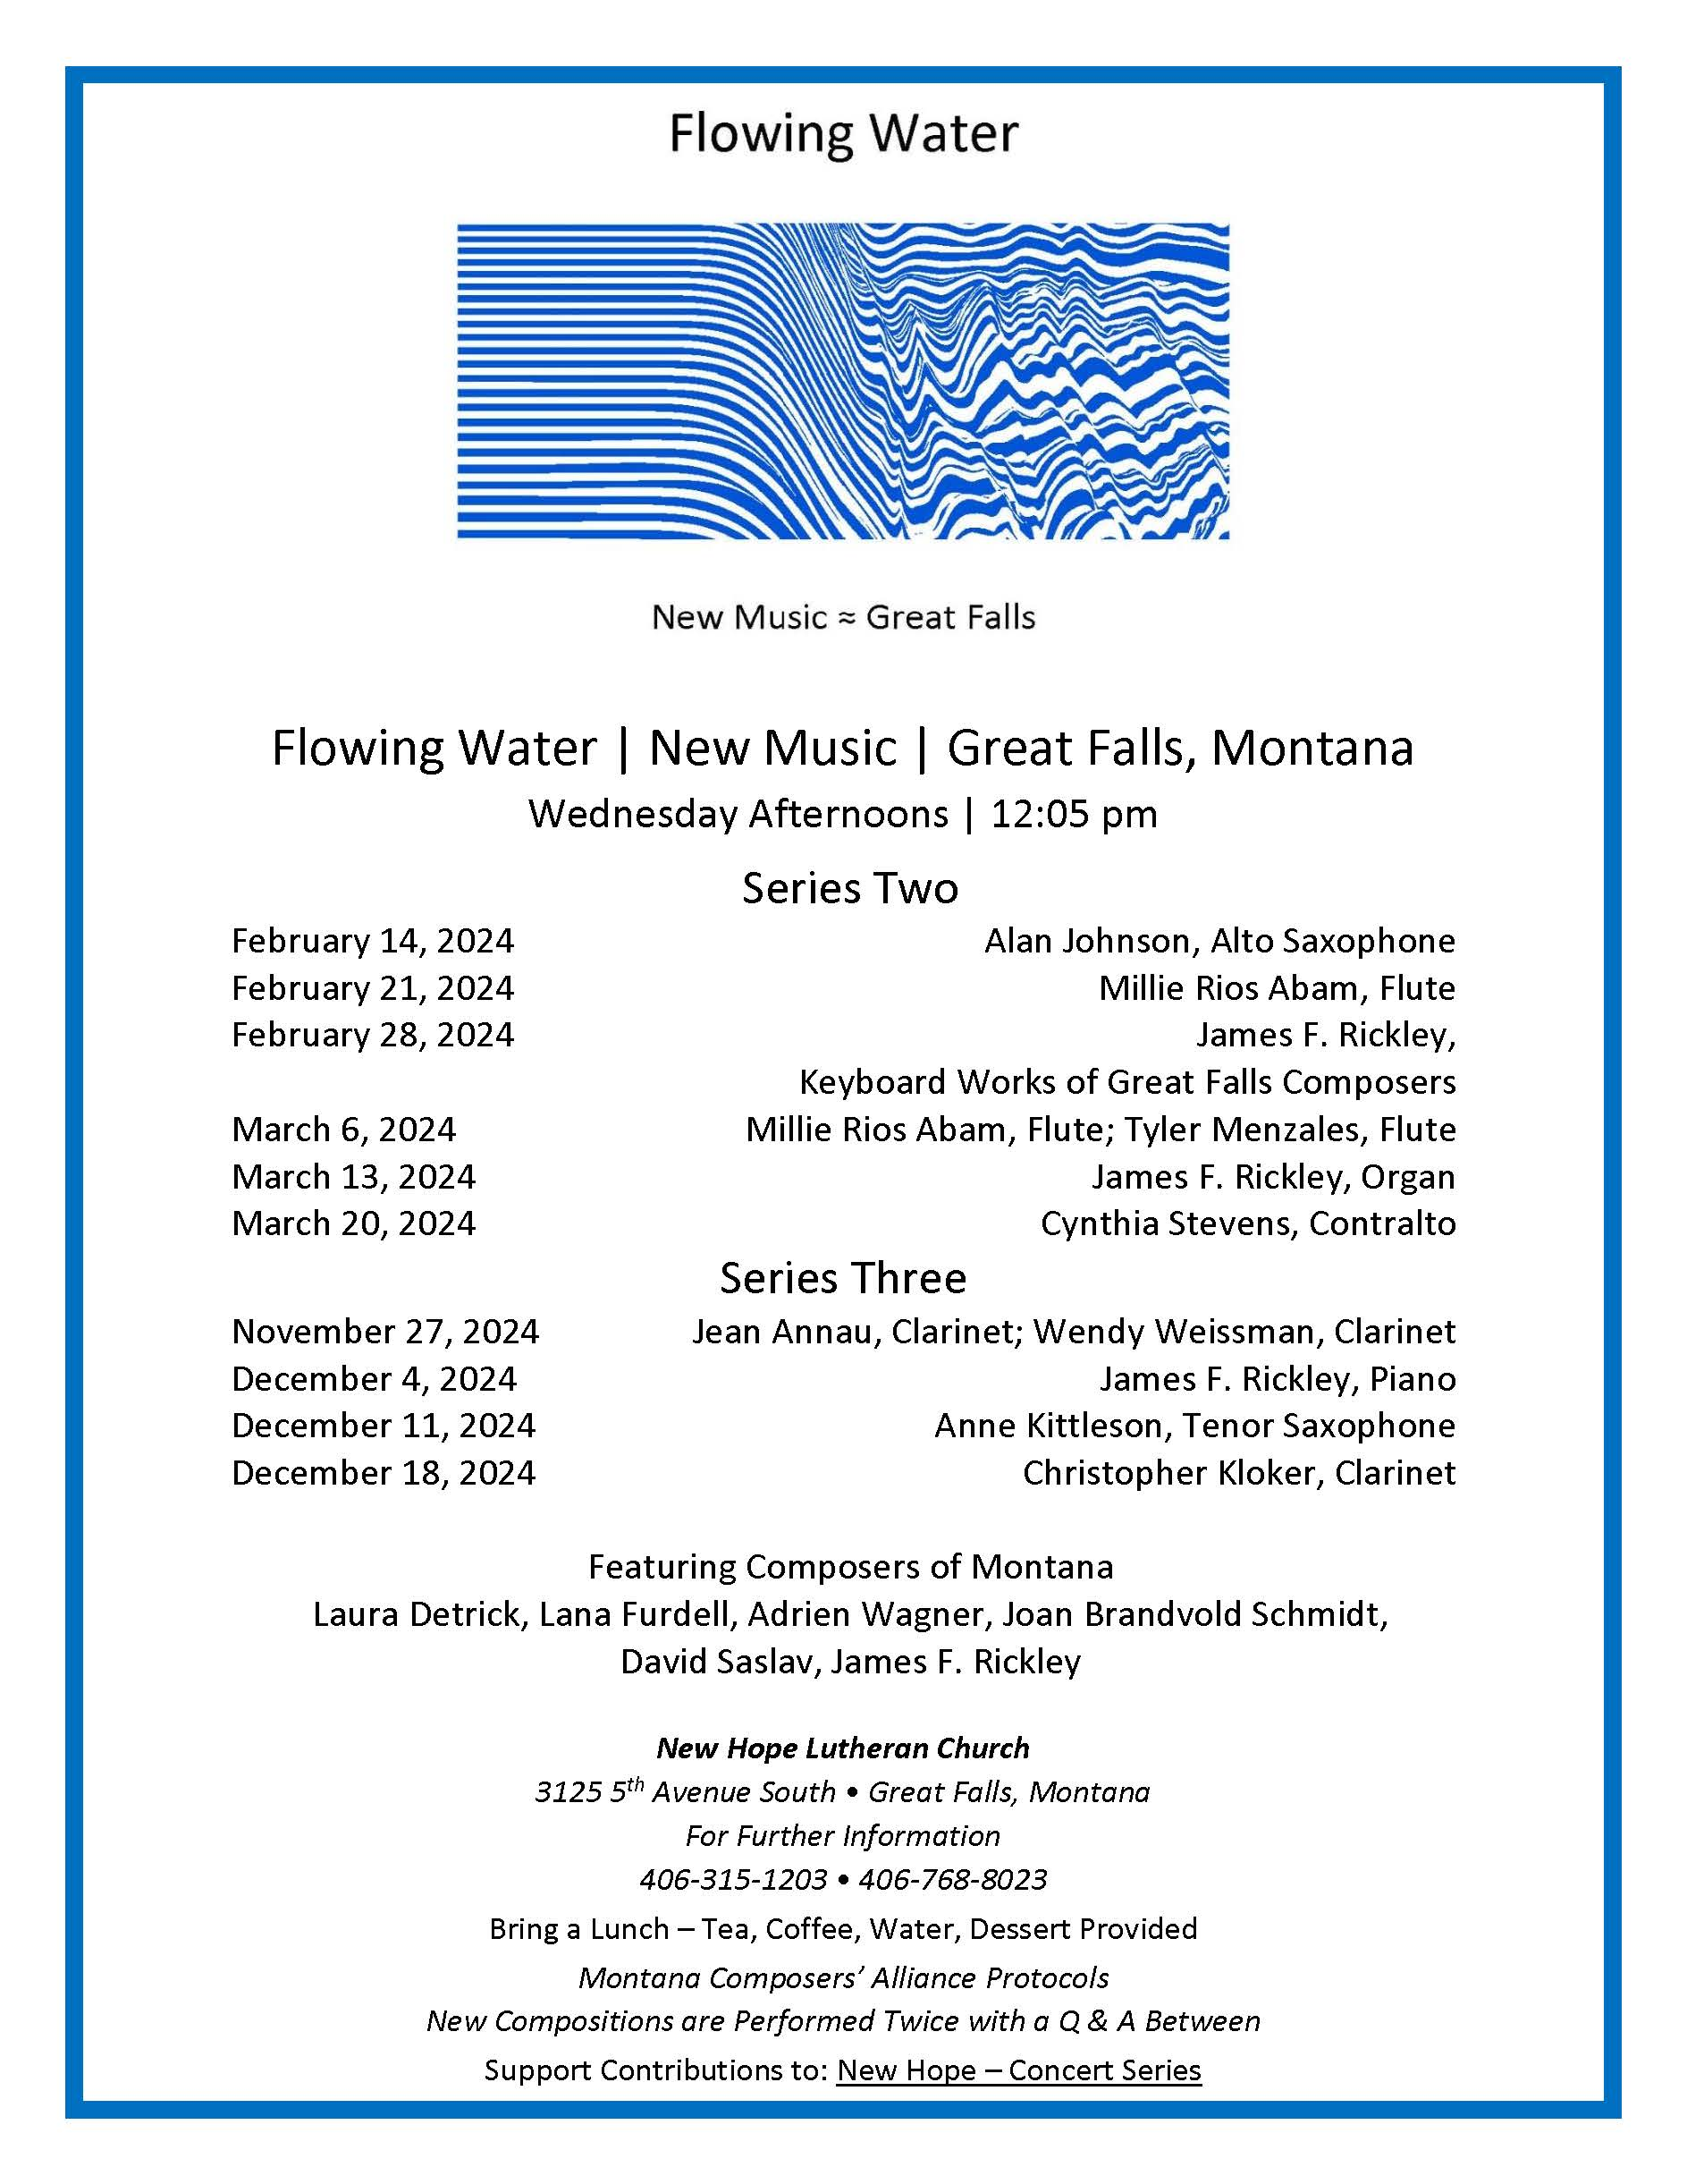

Slide 2
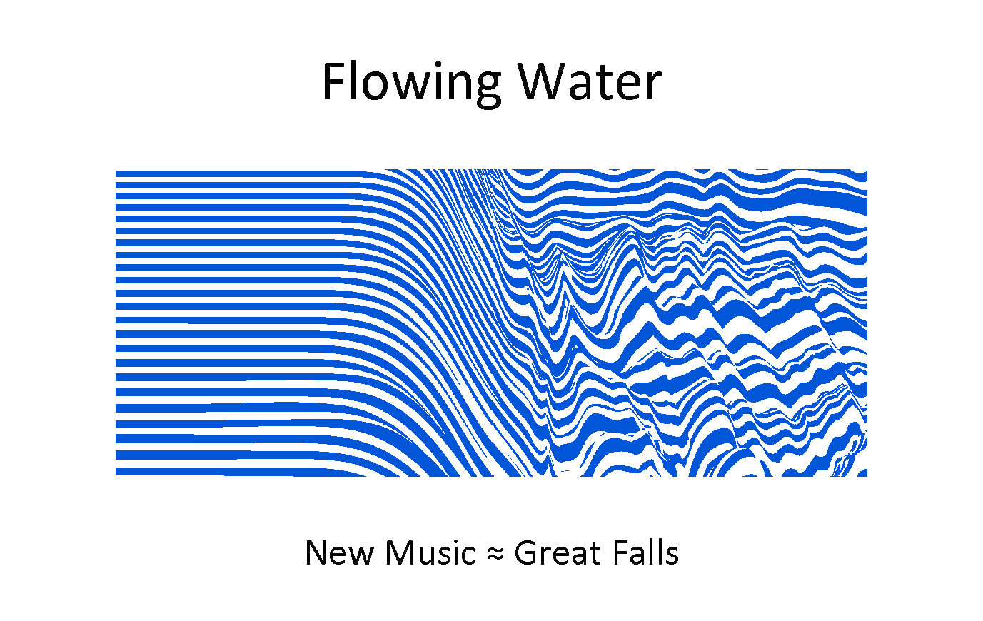
Cynthia Stevens, Contralto
5 Cavafy Poems

Slide 3
1
Old Men’s Souls

Slide 4
2
Waiting for the Barbarians

Slide 5
3
Prayer

Slide 6
4
Trojans

Slide 7
5
An Old Man

Slide 8
Cynthia Stevens, Contralto
5 Cavafy Poems

