Slide 1
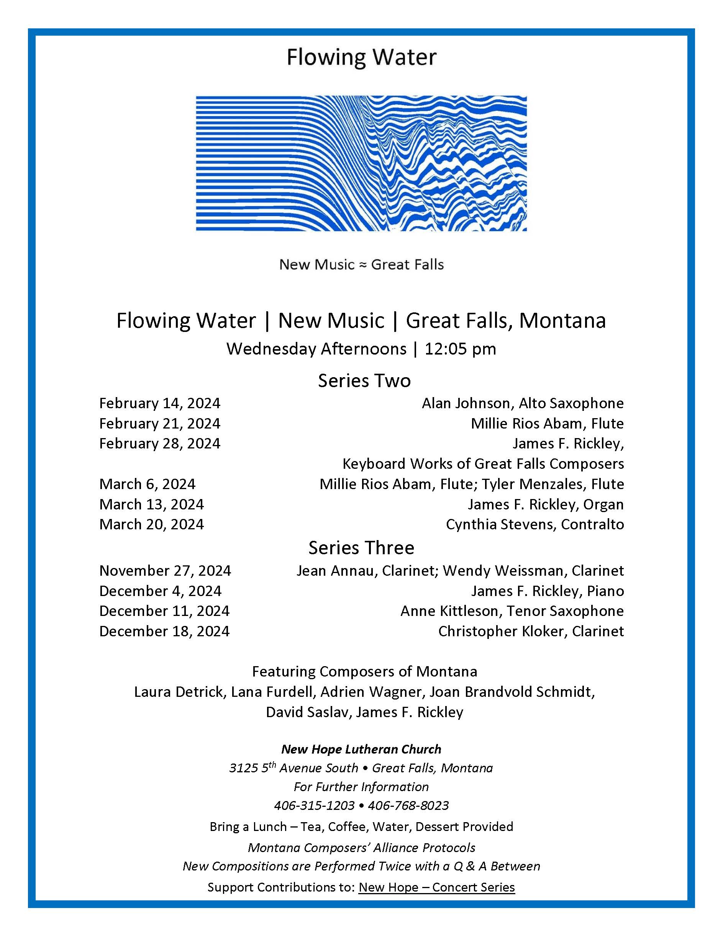

Slide 2
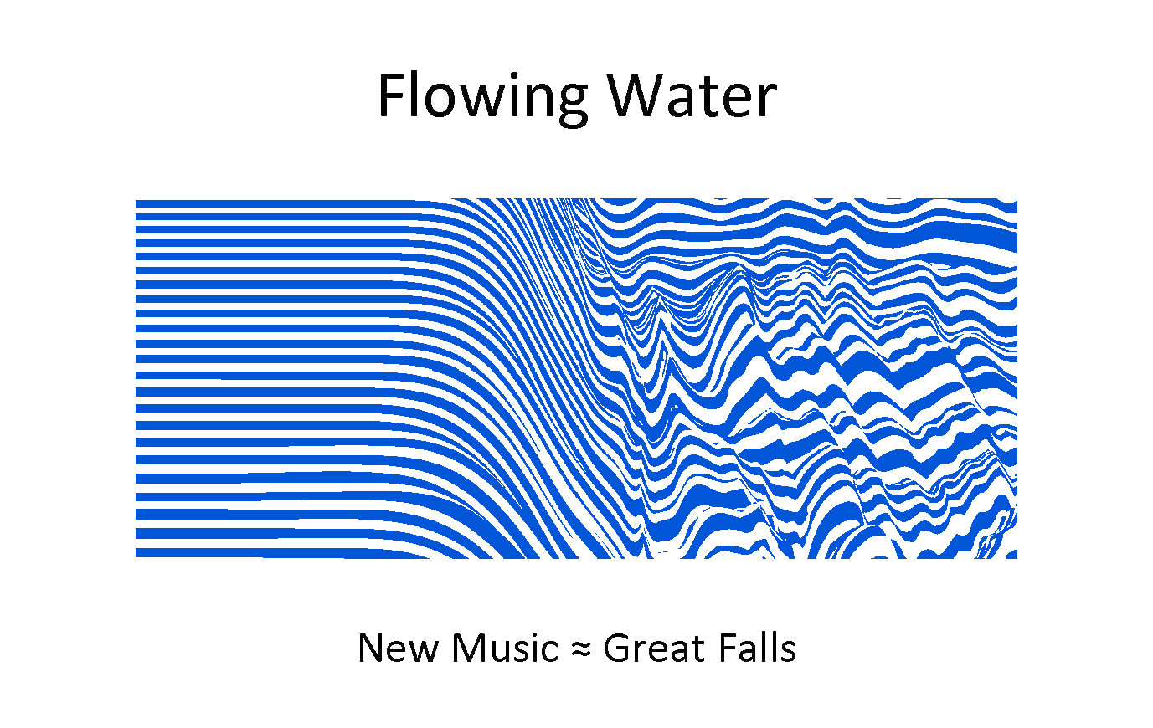
James F. Rickley, Organ
A Sequential Progression
15 Compositions

Slide 3
Tonal Procession 1
Procession
Composed to Celebrate the Wedding of Eileen and Kreg Morton April 13, 1974

Slide 4
Tonal Procession 2
Recessional
Composed to Celebrate the Wedding of Eileen and Kreg Morton April 13, 1974

Slide 5
Tonal Procession 3
Turbulence
Expanding on D

Slide 6
Tonal Procession 4
And So It Is
Expanding on A

Slide 7
Tonal Procession 5
Expanding on C

Slide 8
Tonal Procession 6
Beginnings
Expanding on C

Slide 9
Tonal Procession 7
Expanding on C

Slide 10
Tonal Procession 8
Toccata - Fughetto
Expanding on C

Slide 11
Tonal Procession 9
Toccata
Expanding on D Flat

Slide 12
Tonal Procession 10
Prelude, Fughetta and Chorale
Journey in Major
Expanding on D from B Flat

Slide 13
Tonal Procession 11
Toccata
Concluding on E Flat

Slide 14
Tonal Procession 12
Green
Expounding on D

Slide 15
Tonal Procession 13
Great Mystery
Expounding on D

Slide 16
Tonal Procession 14
Farewell
Expounding Around A

Slide 17
Tonal Procession 15
Fantasia on an American Tune
Chester

Slide 18
James F. Rickley, Organ
A Sequential Progression
15 Compositions

