Slide 1
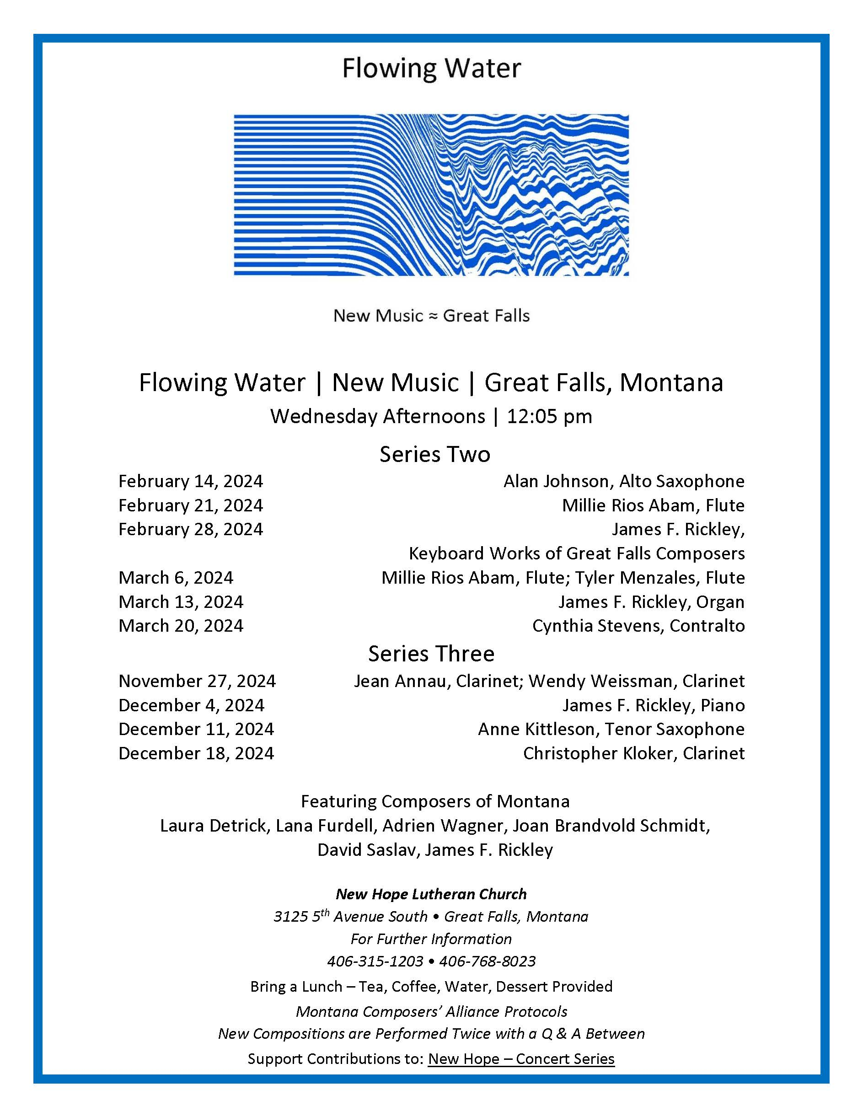

Slide 2

Millie Rios Abam, Flute
Tyler Menzales, Flute
Adventures Together By James F. Rickley
Commissioned by the Montana Arts Council

Slide 3
Adventures Together
1
Knowing

Slide 4
Adventures Together
2
Bonding

Slide 5
Adventures Together
3
Struggle

Slide 6
Adventures Together
4
Stability

Slide 7
Adventures Together
5
Commitment

Slide 8
Adventures Together
6
Bliss

Slide 9
Millie Rios Abam, Flute
Tyler Menzales, Flute
Adventures Together By James F. Rickley
Commissioned by the Montana Arts Council

