Slide 1
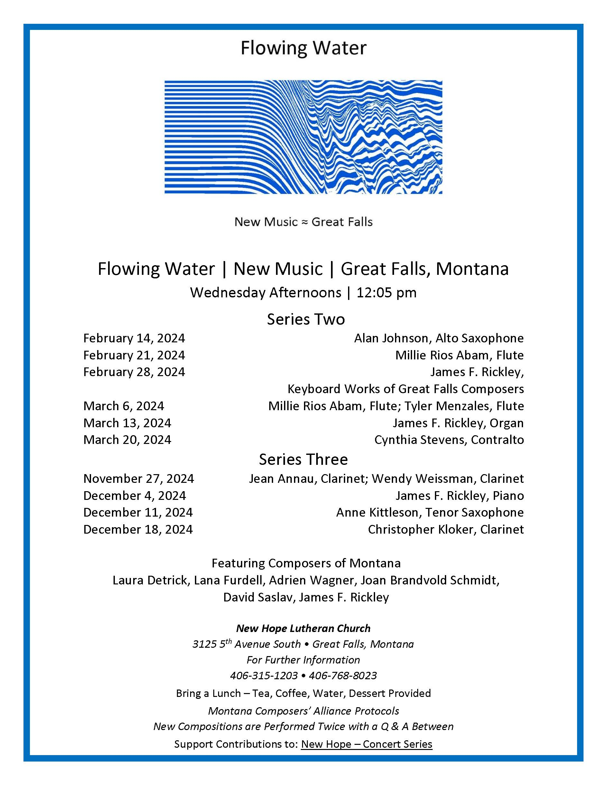

Slide 2
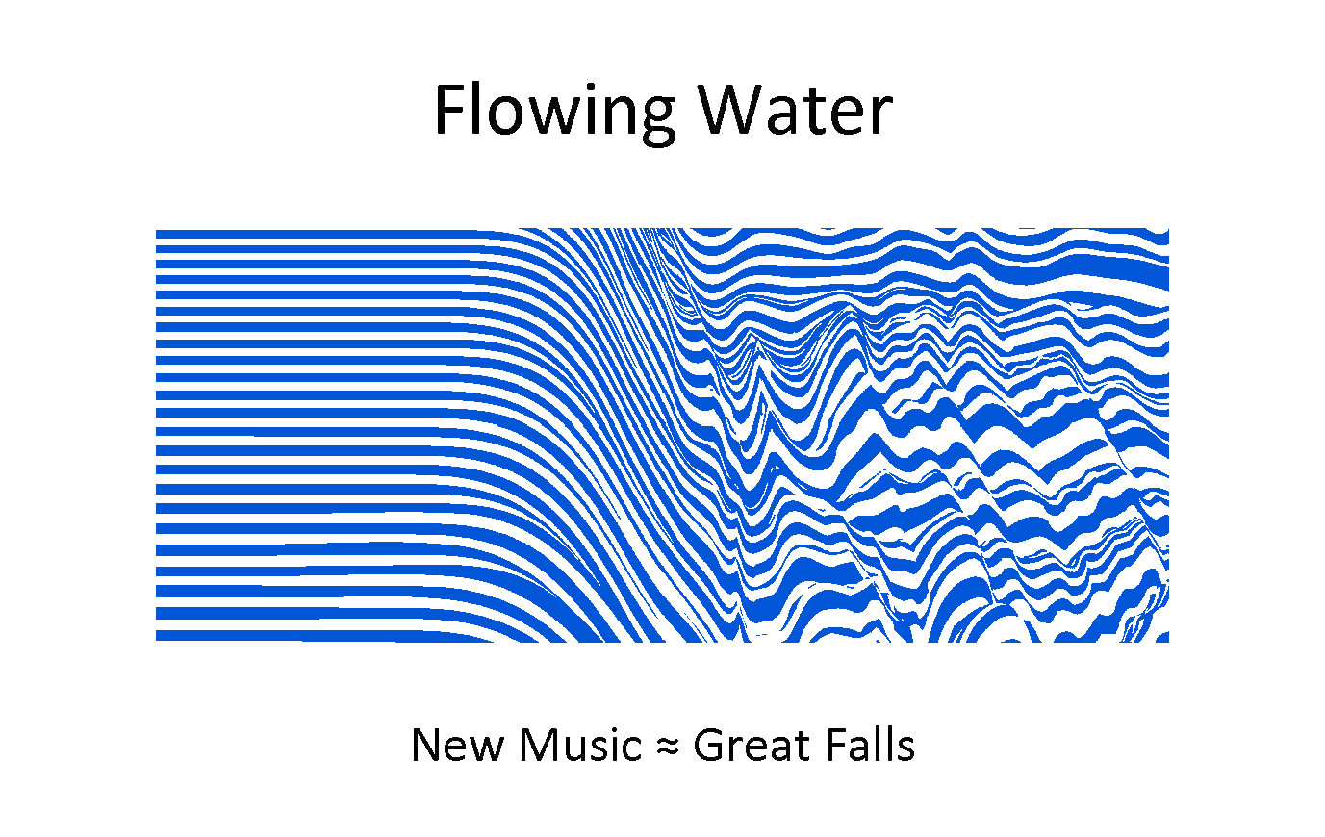
James F. Rickley, Piano, Organ
Works for Keyboard

Slide 3
School Day
2024
Ryan Detrick

Slide 4
Exercise for Piano
1967
James F. Rickley

Slide 5
Invention Imitation
2019
Laura Detrick

Slide 6
Music Flows from Me
2010
Laura Detrick

Slide 7
Rondo a la Puerta Rica
2020
Laura Detrick

Slide 8
Variations on a Russian Theme
2019
Laura Detrick

Slide 9
The Side Porch Light
2020
Laura Detrick

Slide 10
Perpetual Motion Machine #514
2009
David Saslav

Slide 11
Rickley Suite in F
2023
Austin Maurer

Slide 12
Out of Darkness
1970
Lana Nicholls Furdell

Slide 13
Into Light
1970
Lana Nicholls Furdell

Slide 14
Il Bidone
1968
James F. Rickley

Slide 15
James F. Rickley, Piano, Organ
Works for Keyboard

