Slide 1
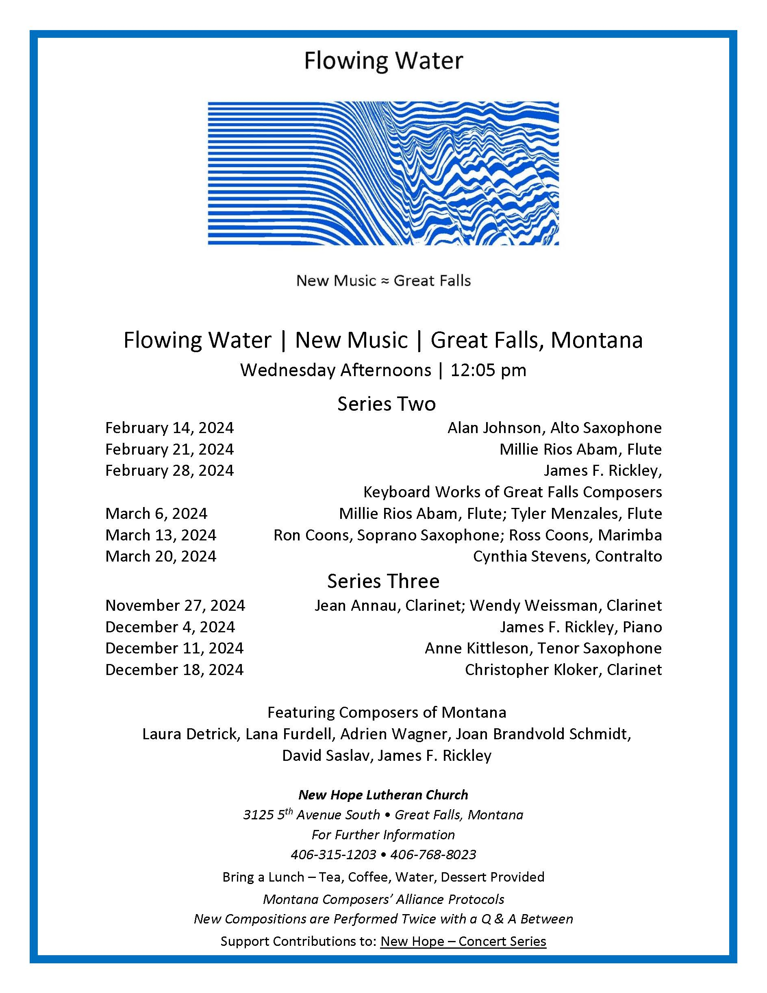

Slide 2
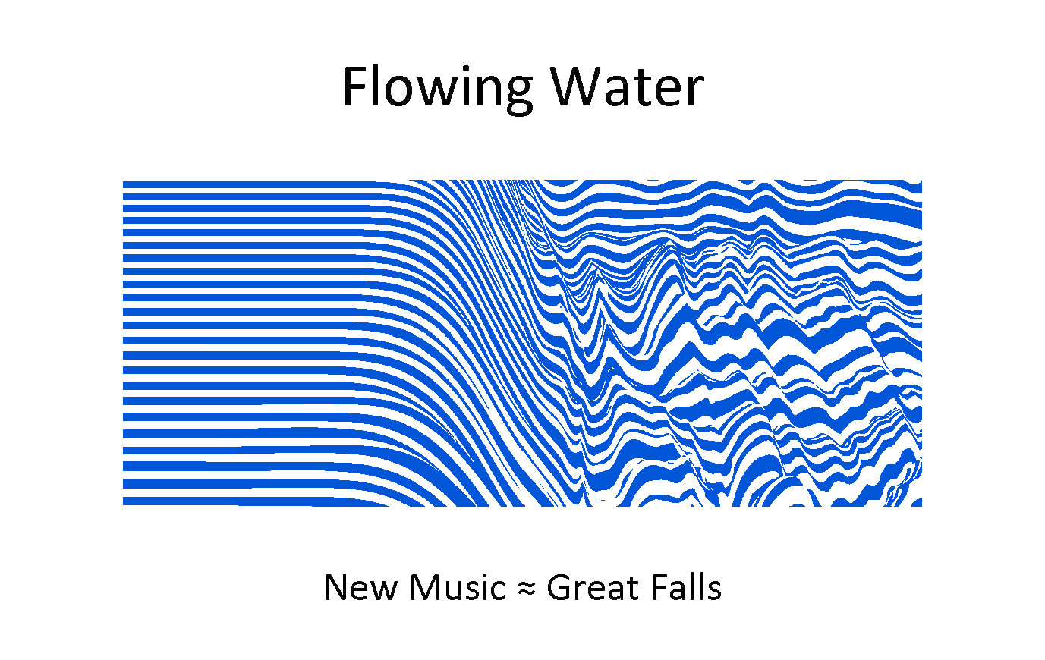
Millie Rios Abam, Flute
A Fissured Seam by James F. Rickley
Of Nancy Jane

Slide 3
A Fissured Seam
1
Overview

Slide 4
A Fissured Seam
2
Fearlessness

Slide 5
A Fissured Seam
3
Amusement

Slide 6
A Fissured Seam
4
Compromised

Slide 7
A Fissured Seam
5
In the Shadow

Slide 8
A Fissured Seam
6
Defiance

Slide 9
A Fissured Seam
7
Aggregation

Slide 10
Millie Rios Abam, Flute
Journeys by James F. Rickley

Slide 11
Journeys
1
Infancy

Slide 12
Journeys
2
The Schoolboy

Slide 13
Journeys
3
The Lover

Slide 14
Journeys
4
The Soldier

Slide 15
Journeys
5
The Justice

Slide 16
Journeys
6
The Pantaloon

Slide 17
Journeys
7
Old Age

Slide 18
Millie Rios Abam, Flute

